Slide 1

Program Design and Structured Techniques
1008_Introduction to Programming
CHAPTER TWO (2) :
Systematic approaches for efficient software development
Compiled by Ms. Dianne Sikinapi & Ms. Odilia Tita
Notes:
---

Slide 2

Introduction
Program Design Importance
Program design plans and organizes code structure to reduce errors and improve software maintainability.
Structured Techniques Principles
Structured techniques use modularity, sequence, selection, and iteration to break down complex problems.
Software Development Stages
Key stages include defining problems, planning, coding, testing, and documenting programs systematically.
Role of Data Types
Data types are essential for writing robust code and ensuring software reliability and scalability.
Notes:
This presentation introduces the foundational concepts of program design and structured techniques, essential for students pursuing a Certificate in Computing. Program design is the process of planning and organizing the structure of a computer program before coding begins. It ensures clarity, reduces errors, and improves maintainability. Structured techniques refer to systematic approaches that break down complex problems into manageable components, using principles such as modularity, sequence, selection, and iteration. These techniques help programmers create reliable, efficient, and scalable software solutions. The presentation will cover key stages in the software development process, including defining the problem, planning the solution, coding, testing, and documenting programs. Additionally, it will explore structured programming principles and data types, which are critical for writing robust code. By the end of this session, learners will understand why program design matters, how structured techniques enhance quality, and the role of data types in programming. This knowledge forms the backbone of professional software development practices and prepares students for real-world programming challenges.

Slide 3
Learning Objectives
By the end of this Unit, students should be able to;
Understand the need for Program Design
Know the Program Design and the importance for Program Design
Define the problem and know what Top-Down Design is
Know how to plan the solution using Flowcharts and Pseudo code
Learn how to translate logic from flowcharts and pseudo code to program code using visual Basic programming language
Learn to test the program and the steps involved in Program Testing
Learn what Structured Programming is and its constructs
Resource: Textbook - Introduction to Programming Book 1 Pages 25 - 48

Slide 4
Learning Objectives
Program Design Importance
Understand how program design reduces complexity and improves software reliability while minimizing development errors.
Problem Definition
Learn accurate problem definition steps crucial for creating effective software solutions.
Planning Techniques
Explore flowcharts, algorithms, and pseudocode as essential blueprints guiding software coding.
Coding Best Practices
Gain insights into coding standards such as syntax adherence, readability, and maintainability for quality code.
Testing and Debugging
Emphasize testing and debugging techniques to ensure software correctness and performance.
Documentation Practices
Understand documentation methods that aid future maintenance and user comprehension.
Structured Programming Principles
Learn structured programming and data types to write modular, logical, and efficient programs.
Notes:
The learning objectives of this module are designed to provide a comprehensive understanding of program design and structured techniques. First, students will learn the importance of program design in reducing complexity and improving software reliability. This includes understanding how planning impacts efficiency and minimizes costly errors during development. Second, learners will explore the steps involved in defining a problem accurately, which is crucial for creating effective solutions. Third, the presentation will guide students through planning techniques such as flowcharts, algorithms, and pseudocode, which serve as blueprints for coding. Fourth, participants will gain insights into coding best practices, including adherence to syntax rules, readability, and maintainability. Fifth, the module emphasizes the significance of testing and debugging to ensure program correctness and performance. Sixth, students will understand documentation practices that support future maintenance and user comprehension. Finally, the session introduces structured programming principles and data types, enabling learners to write modular, logical, and efficient programs. These objectives collectively prepare students for professional programming tasks and enhance problem-solving skills.

Slide 5
2.1 Understanding the Need for Program Design
Programmers learn to develop patience early in their programming careers. They learnt that proper design is critical to the successful program.
Programs are developed because there is a problem that must be solved. The practice of analyzing the problem and then designing the program for that analysis is called systems analysis and design.
(Refer to the scenario of a builder on Page 26.)
Nothing can be built unless the builder has an end result in mind. This same theory applies to a programmer as well, you cannot go to the keyboard and start typing instructions into the program before designing it.
With the help of computer technology, computer programs are easily modified than a house. If you leave a routine that the user wanted for that program, you can add it more easily than a builder can add a room to a finished house.

Slide 6
Program maintenance takes place after the program is written, tested, and distributed. It is one of the most time consuming aspects of programming process.
Programs are continually updated to reflect new user needs. Sometimes if the program is not designed properly before it is written, the user will not want the program until it does exactly what the user wants.
Computer consultants and programmers learn early to get the users acceptance and even the user’s signatures before the programs begins. If both the user and the programmer agree on what to do, there is little room for disagreements when the final program is presented.
Companies with internal data processing departments also require that their programming staffs come to written arguments with the users who want them to write the programs. This is because company resources are limited; there is no time to add something later that should have been in the system all along.

Slide 7
2.2 Steps in Program Development
Developing a computer program involves steps similar to any problem solving task. There are five main steps that programmers take to write programs:
Step 1: Defining the Problem
Step 2: Planning the Solution
Step 3: Coding the Program
Step 4: Testing the Program
Step 5: Documenting the Program

Slide 8
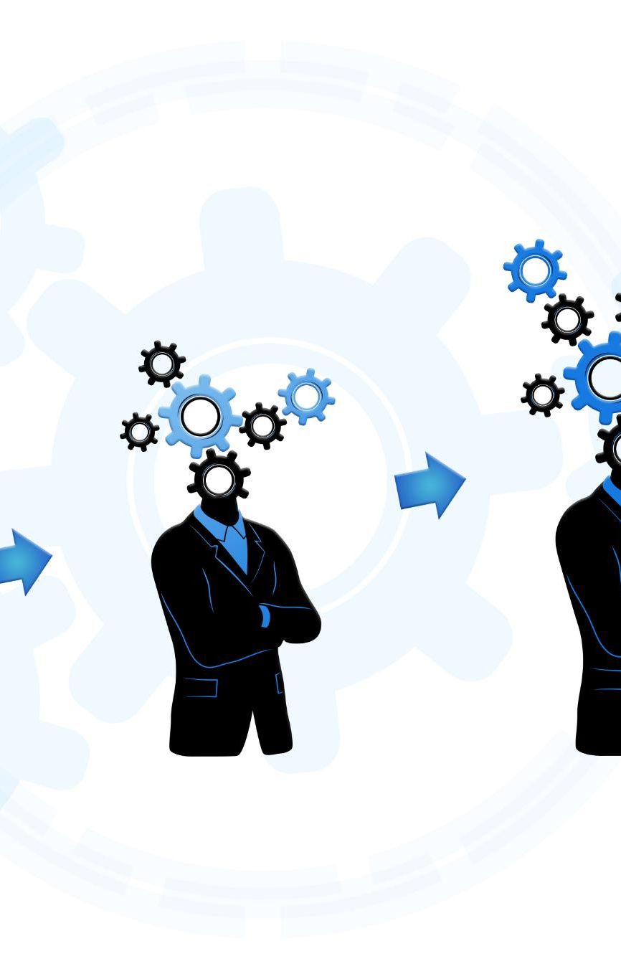
Why Program Design Matters?
Foundation for Success
Program design establishes a clear structure and flow, enabling smoother development and fewer ambiguities.
Error Reduction
Thorough design helps identify logical flaws early, reducing bugs and costly fixes during implementation.
Modular Efficiency
Design promotes modular development, allowing component reuse that improves efficiency and scalability.
Enhanced Collaboration and Learning
Good design improves testing, documentation, and teamwork while fostering problem-solving skills in education.
Notes:
Program design is a critical phase in software development because it lays the foundation for successful implementation. Without proper design, programs often suffer from inefficiencies, bugs, and poor maintainability. One key reason design matters is that it provides clarity by defining the program’s structure and flow before coding begins. This reduces ambiguity and helps developers anticipate potential challenges. Another benefit is error reduction; by planning thoroughly, developers can identify logical flaws early, avoiding costly fixes later. Design also improves efficiency by enabling modular development, where components can be reused across projects. For example, large organizations like Microsoft and Google rely on rigorous design processes to ensure scalability and reliability in their software products. Furthermore, well-designed programs are easier to test and document, which accelerates development cycles and enhances collaboration among teams. In educational settings, teaching design principles equips students with problem-solving skills that extend beyond programming, fostering analytical thinking and systematic approaches to complex tasks.

Slide 9
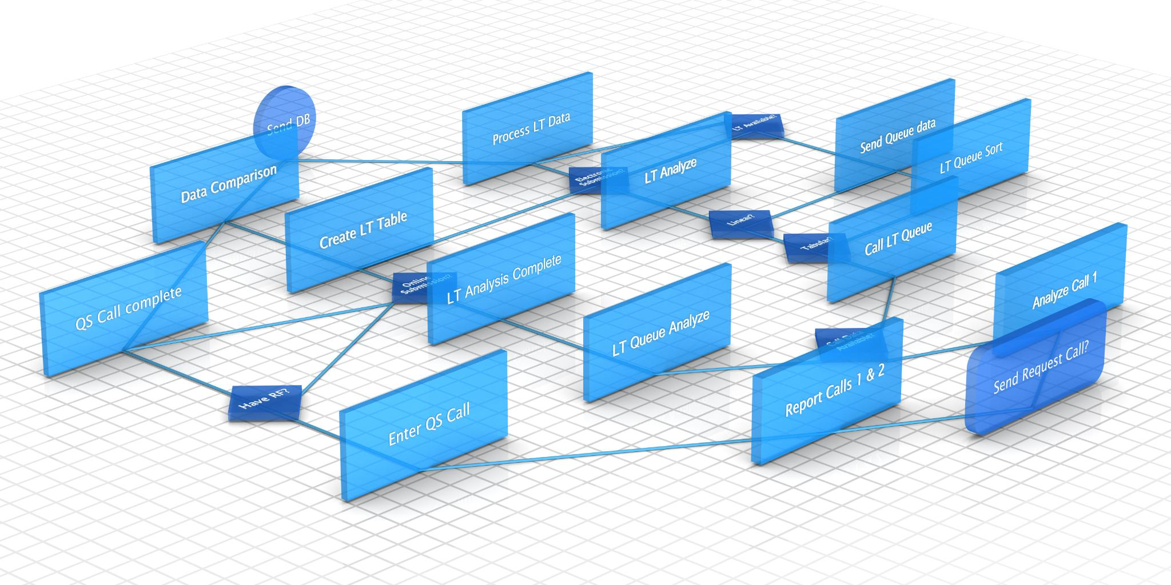
Benefits of Structured Design
Modularity and Manageability
Structured design breaks large problems into smaller modules, simplifying debugging and maintenance.
Improved Readability and Collaboration
Enhances code readability and documentation, facilitating team collaboration and future maintenance.
Scalability and Adaptability
Supports scalability allowing programs to grow without major rewrites, adapting to evolving needs.
Alignment with Industry Standards
Structured design follows best practices and aligns with methodologies like Agile and Waterfall.
Notes:
Structured design offers numerous benefits that make it indispensable in modern programming. First, it promotes modularity, allowing developers to break down large problems into smaller, manageable units. This modular approach simplifies debugging and maintenance because changes in one module rarely affect others. Second, structured design enhances readability and documentation, making it easier for teams to collaborate and for future developers to understand the code. Third, it supports scalability; programs designed using structured techniques can be expanded without major rewrites. For instance, enterprise systems often rely on structured design to accommodate growing user bases and evolving requirements. Additionally, structured design aligns with industry standards and best practices, ensuring compatibility with widely used development methodologies such as Agile and Waterfall. By emphasizing logical flow and clear control structures, structured design minimizes errors and improves overall software quality. These advantages underscore why structured design is a cornerstone of professional programming and why it is emphasized in computing education.

Slide 10
2.2.1: Step 1 – Defining the Problem
Knowing the objective is the first consideration
What is it that your client really want the program to do?
What kind of program is this? Is it a Payroll or editing program?
Who will be the end user of that program?
Determining the inputs, processes, and output is next
How will the program operate?
What data is needed to make it happen?
Feasibility is the next consideration
How many programmers will it take?
Is the project within budget?
Does the project have a realistic outline?

Slide 11
Before beginning a program, you must have a firm idea of what the program should produce. You will see that the output is the last thing produced but it is the first thing you must design – a programmer must know what output is going to be before writing the program.
Anything that the program produces and the user sees it is considered as output that you must define. So defining the output also help you gather all the input you needed to produce the output.
The output also gives you insight into what type of data elements the program should track, compute and produce.
One of the best approach to do this is using the Top-Down Design.

Slide 12
Top – Down Design
Top-down is the process of breaking down the overall problem into more and more detail, until you finalize all the details. With this design, the details fallout clearly.
It is the recommended way of approaching any problems, but most programmers tend not to use it, instead they tend to design it from opposite direction (bottom-up).
Top-down design has 3 step process that are necessary.
Determine the overall goal
Break the goal into two, three, or more detailed parts. (Too many more details make you leave out things.)
Put off the details as long as possible. Keep repeating steps 1 and 2 until you cannot reasonably break down the problem any further.

Slide 13
Top-down design is not just for programming problems. Once you master top-down design, you can apply it to any part of your life that you must plan in detail.
Moving to a computerized problem, assume that you are a programmer and you are assigned the task of writing a payroll program for a company. You should start with the first step by Defining the Problem. What will that payroll program require?
The perfect place to start is at the top, and that can be done using the top-down design. (See figure 2.1 page 29 as the first step.) You must keep breaking down each component until all details finally appear.
The details stemming from this design are not the output. Many of these details are procedures the final program must perform. It is your responsibility as a programmer to make sure the output consist of and looks exactly like what the user wants to see in the final program. This process is called output definition.

Slide 14

Steps in Problem Definition
Requirement Gathering
Developers engage stakeholders to understand needs and align objectives with business goals.
Analyzing Constraints
Budget, time, and technical limitations are evaluated to define feasible development approaches.
Defining Inputs and Outputs
Identify program inputs, outputs, and processing to form the foundation of program logic.
Use of Documentation Tools
Requirement specification documents and use case diagrams help capture and communicate problem details.
Notes:
Defining the problem is the first and most crucial step in program development. It involves identifying the exact issue the program aims to solve and clarifying the objectives. The process begins with requirement gathering, where developers interact with stakeholders to understand their needs and expectations. This step ensures that the solution aligns with user requirements and business goals. Next, constraints such as budget, time, and technical limitations are analyzed to determine feasible approaches. Developers also identify inputs, outputs, and processing requirements, which form the basis of the program’s logic. For example, in designing a payroll system, the problem definition would include calculating salaries, deductions, and generating payslips. Clear problem definition prevents scope creep and reduces the risk of delivering an ineffective solution. Tools like requirement specification documents and use case diagrams are often employed to capture and communicate problem details. By investing time in this phase, developers set the stage for accurate planning and successful implementation.

Slide 15

Common Challenges in Problem Definition
Incomplete or Ambiguous Requirements
Unclear requirements cause misunderstandings and flawed solutions, impacting overall project success.
Scope Creep Issues
Changing requirements during development add features without proper review, leading to delays and budget overruns.
Communication Gaps
Differences between technical and non-technical teams cause misunderstandings of complex concepts.
Overcoming Challenges
Using validation sessions, prototypes, and feedback loops ensures shared understanding and project alignment.
Notes:
While defining the problem is essential, it comes with challenges that can impact project success. One common issue is incomplete or ambiguous requirements, which lead to misunderstandings and flawed solutions. For instance, if stakeholders fail to specify performance expectations, developers may create systems that cannot handle real-world workloads. Another challenge is changing requirements during development, often referred to as scope creep. This occurs when new features are added without proper evaluation, causing delays and budget overruns. Communication gaps between technical teams and non-technical stakeholders also pose difficulties, as complex concepts may not be easily understood. To overcome these challenges, developers use techniques such as requirement validation sessions, prototypes, and iterative feedback loops. These practices ensure that all parties have a shared understanding of the problem. By addressing these challenges proactively, teams can avoid costly mistakes and deliver solutions that meet user needs effectively.

Slide 16
2.2.2: Step 2 – Planning the Solution
After you and the user agree to the goals and output of the programs, the rest is up to you as the programmer. Your job is to take the output definition and decide how to make a computer produce the output.
You have already taken the overall problem and broken it down into detailed instruction that the computer can carry out. You are now ready to develop the logic that produces the output. Writing and designing Algorithms helps you achieve this.
Algorithms are descriptions of how to solve problems. An algorithm is a solution description. It is the most important tool in developing software and applications.
There are two most commonly used algorithm approaches.

Slide 17
i. Flowchart
What is a Flowchart?
A flowchart is a pictorial representation of a step-by-step solution to a problem. It consists of arrows representing the direction the program takes and other shapes/symbols representing actions.
Flowcharts does not include all the program details but represent the general logic flow of the program.
Flowcharts break down a complex process into smaller, more manageable steps, making it easier to analyze and understand program logic. It is a valuable tool during the programming design and planning stages, as it helps the programmer identify potential problems, optimize algorithms, and communicate ideas to team members.
The American National Standards Institute (ANSI) have developed a standard set of flowchart symbols which are referred to as the industry-standard symbols, which all flowcharts in programming must use.

Slide 18
Industry-standard Flowchart symbols
Symbol | Description
Process | Use when a process is taking place (Contains a description of what is being done).
Decision | Use when the program must make a decision based on two outcomes.
Input/Output | Use for any input/output the program does.
Terminal | Use with the word ‘Begin’ or ‘Start’ to show the starting of a program. Use with the word ‘Finish’ or ‘End’ to show the ending of a program

Slide 19
Symbol | Description
Off-page flow connector | Use at the bottom of the page of any flowchart that is continued on to another page.
On-page flow connector | Use at the bottom of the page of any flowchart that is continued to another page.
Flow direction | These arrows connect every symbol in the flowchart and indicate the direction of the program flow.

Slide 20
There are also flowcharting rules that must be followed when drawing a flowchart. These rules are:
Use standard flowcharting symbols.
The flowchart logic should follow from top of page to bottom of page, and from left to right.
The decision symbol is the only symbol that has more than one exit point, and it always has two.
A decision symbol should always ask a ‘yes’ or ‘no’ question.
Instructions inside the symbols must be clear English descriptions, not computerized or programming language statements.

Slide 21
ii. Pseudo code
What is a Pseudo code?
Pseudo code is an informal, high-level description of a computer program or algorithm. It is not meant to be a formal programming language, but rather a way to describe the logic and steps of an algorithm in a way that can be read and understood by humans.
The rules of Pseudo code are reasonably straightforward. That is, all statements showing ‘dependency’ are to be indented.
A pseudo code is not executable on the computer.
The Pseudo code approach is also used in Planning a Solution.

Slide 22

Using Algorithms and Flowcharts
Algorithm Definition
An algorithm is a step-by-step procedure to solve problems in a logical sequence before coding starts.
Flowchart Role
Flowcharts visually represent program logic using standardized symbols for processes, decisions, and data flow.
Example: Login System
Flowchart example for login illustrates input validation, authentication, and error handling steps clearly.
Benefits in Development
Using algorithms and flowcharts reduces debugging time and improves communication among teams.
Notes:
Planning the solution involves creating a roadmap for how the program will function. Algorithms and flowcharts are two essential tools in this process. An algorithm is a step-by-step procedure for solving a problem, expressed in a logical sequence. It provides clarity and ensures that all necessary steps are considered before coding begins. Flowcharts complement algorithms by offering a visual representation of the program’s logic. They use standardized symbols to depict processes, decisions, and data flow, making complex logic easier to understand. For example, a flowchart for a login system would illustrate steps such as input validation, authentication, and error handling. These tools help developers identify inefficiencies and logical errors early, reducing debugging time later. Additionally, they facilitate communication among team members and stakeholders, as visual diagrams are easier to interpret than textual descriptions. By incorporating algorithms and flowcharts into the planning phase, developers create structured, efficient, and error-resistant solutions.

Slide 23
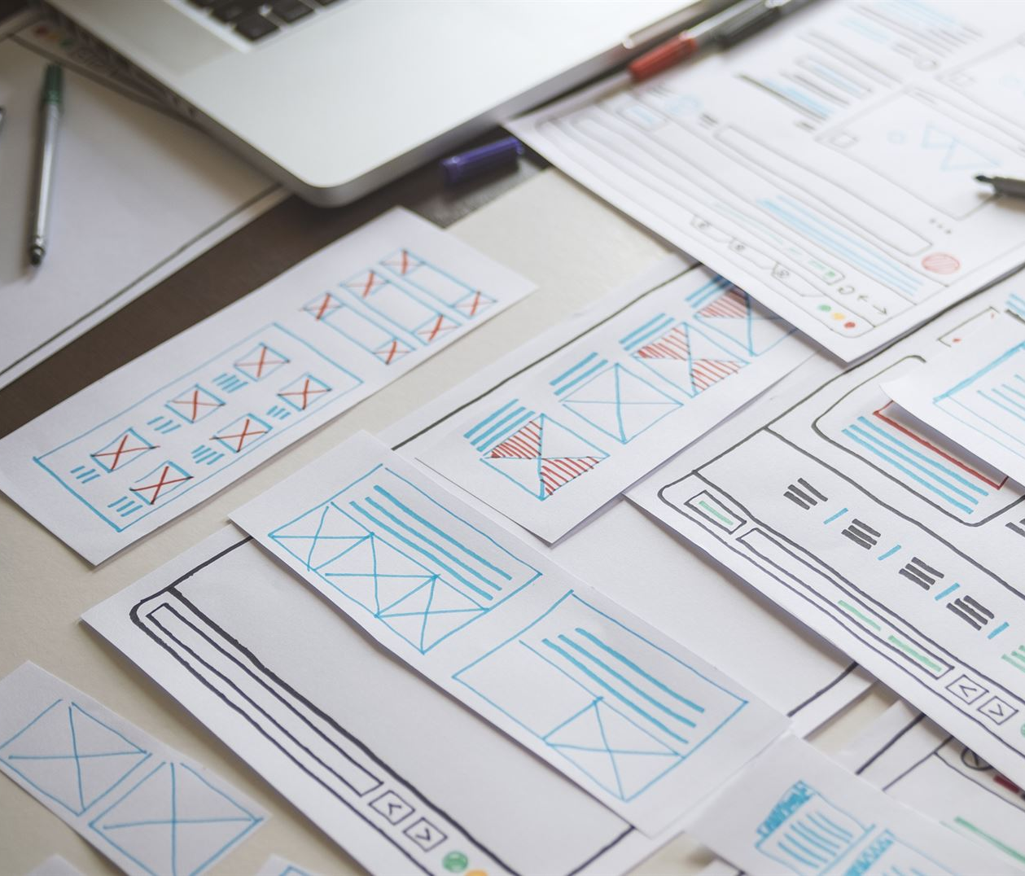
Role of Pseudocode in Design
Simplified Program Logic
Pseudocode represents program logic in plain English without focusing on syntax or language details.
Bridging Design and Coding
Pseudocode acts as a bridge between program design and implementation, guiding developers during coding.
Educational Tool
Pseudocode helps students focus on problem-solving without the complexity of language-specific syntax.
Error Reduction and Efficiency
Using pseudocode allows developers to refine logic early, reducing errors and improving coding efficiency.
Notes:
Pseudocode is another powerful tool used in planning program solutions. It is a simplified, language-independent representation of the program’s logic, written in plain English. Unlike actual code, pseudocode focuses on the structure and flow rather than syntax, making it accessible to both technical and non-technical stakeholders. For instance, pseudocode for a sorting algorithm might outline steps such as initializing variables, comparing elements, and swapping positions without specifying programming language details. This approach allows developers to refine logic before committing to code, reducing errors and improving efficiency. Pseudocode also serves as a bridge between design and implementation, guiding programmers during coding. It is particularly useful in educational settings, where students can focus on problem-solving without being overwhelmed by language-specific syntax. By using pseudocode, developers ensure that the program’s logic is sound, clear, and easy to translate into any programming language.

Slide 24
2.2.3: Step 3 – Coding the Program
As the programmer, your next step is to code the program, that is to express your solution in a programming language. You will translate the logic from the flowchart or pseudo code (or some other tool) to a programming language.
Although programming languages operate grammatically, somewhat like the English language, they are much more precise. To get your program to work, you have to follow exactly the rules or the syntax of the programming language you are using.
Programmers usually use a text editor to create a file that contains the program.
A programming text editor is a software tool used to create and edit text files, usually in programming languages. Text editors are fundamental tools for programmers and developers because they provide a foundation for writing, modifying, and managing code.
However, as a beginner, you will probably want to write your codes on a paper first.

Slide 25

Best Practices in Coding
Consistent Naming Conventions
Using consistent names for variables and functions improves code readability and maintainability.
Modular Code Design
Dividing code into reusable, independent modules reduces duplication and simplifies maintenance.
Clear Comments and Simplicity
Writing comments to explain complex logic and avoiding overly complicated structures enhances clarity.
Error Handling and Validation
Anticipating errors and validating user input prevents crashes and unexpected behavior.
Notes:
Coding is the phase where design is transformed into executable instructions. Adhering to best practices during coding ensures that programs are efficient, maintainable, and error-free. One key practice is following consistent naming conventions for variables and functions, which improves readability. Another is writing modular code by dividing functionality into reusable components, reducing duplication and simplifying maintenance. Developers should also prioritize clarity by using comments to explain complex logic and avoiding overly complicated structures. Error handling is another critical aspect; programs should anticipate and manage exceptions gracefully to prevent crashes. For example, validating user input before processing prevents unexpected behavior. Additionally, adhering to language-specific standards and using version control systems like Git enhances collaboration and code integrity. By implementing these practices, developers create robust programs that are easier to debug, test, and extend, ultimately delivering higher-quality software.

Slide 26

Importance of Readability and Maintainability
Readable Code Importance
Readable code is easy to understand, enabling effective team collaboration and future updates.
Maintainability Benefits
Maintainable code allows easy modification for bug fixes and new features, reducing costs.
Consequences of Poor Code
Poorly written code causes technical debt, increasing time and cost for future changes.
Notes:
Readability and maintainability are essential qualities of well-written code. Readable code is easy to understand, even for someone unfamiliar with the project, which is crucial for team collaboration and future updates. Techniques to improve readability include using descriptive variable names, consistent indentation, and clear logical structures. Maintainability refers to the ease with which code can be modified to fix bugs or add new features. Modular design, proper documentation, and adherence to coding standards all contribute to maintainability. For instance, large-scale systems like banking applications require maintainable code to adapt to regulatory changes without disrupting operations. Poorly written code, on the other hand, leads to technical debt, making future modifications costly and time-consuming. By prioritizing readability and maintainability, developers ensure that their programs remain functional and adaptable throughout their lifecycle, reducing long-term costs and improving overall software quality.

Slide 27
2.2.4: Step 4 – Testing the Program
Some experts insists that a well-designed program can be written correctly the first time. However, most programmers get used to the idea that their newly written programs probably have a few errors.
So after coding the program, you must prepare to test it on the computer. This step involves the following three phases:
Desk checking
Translating
Debugging

Slide 28
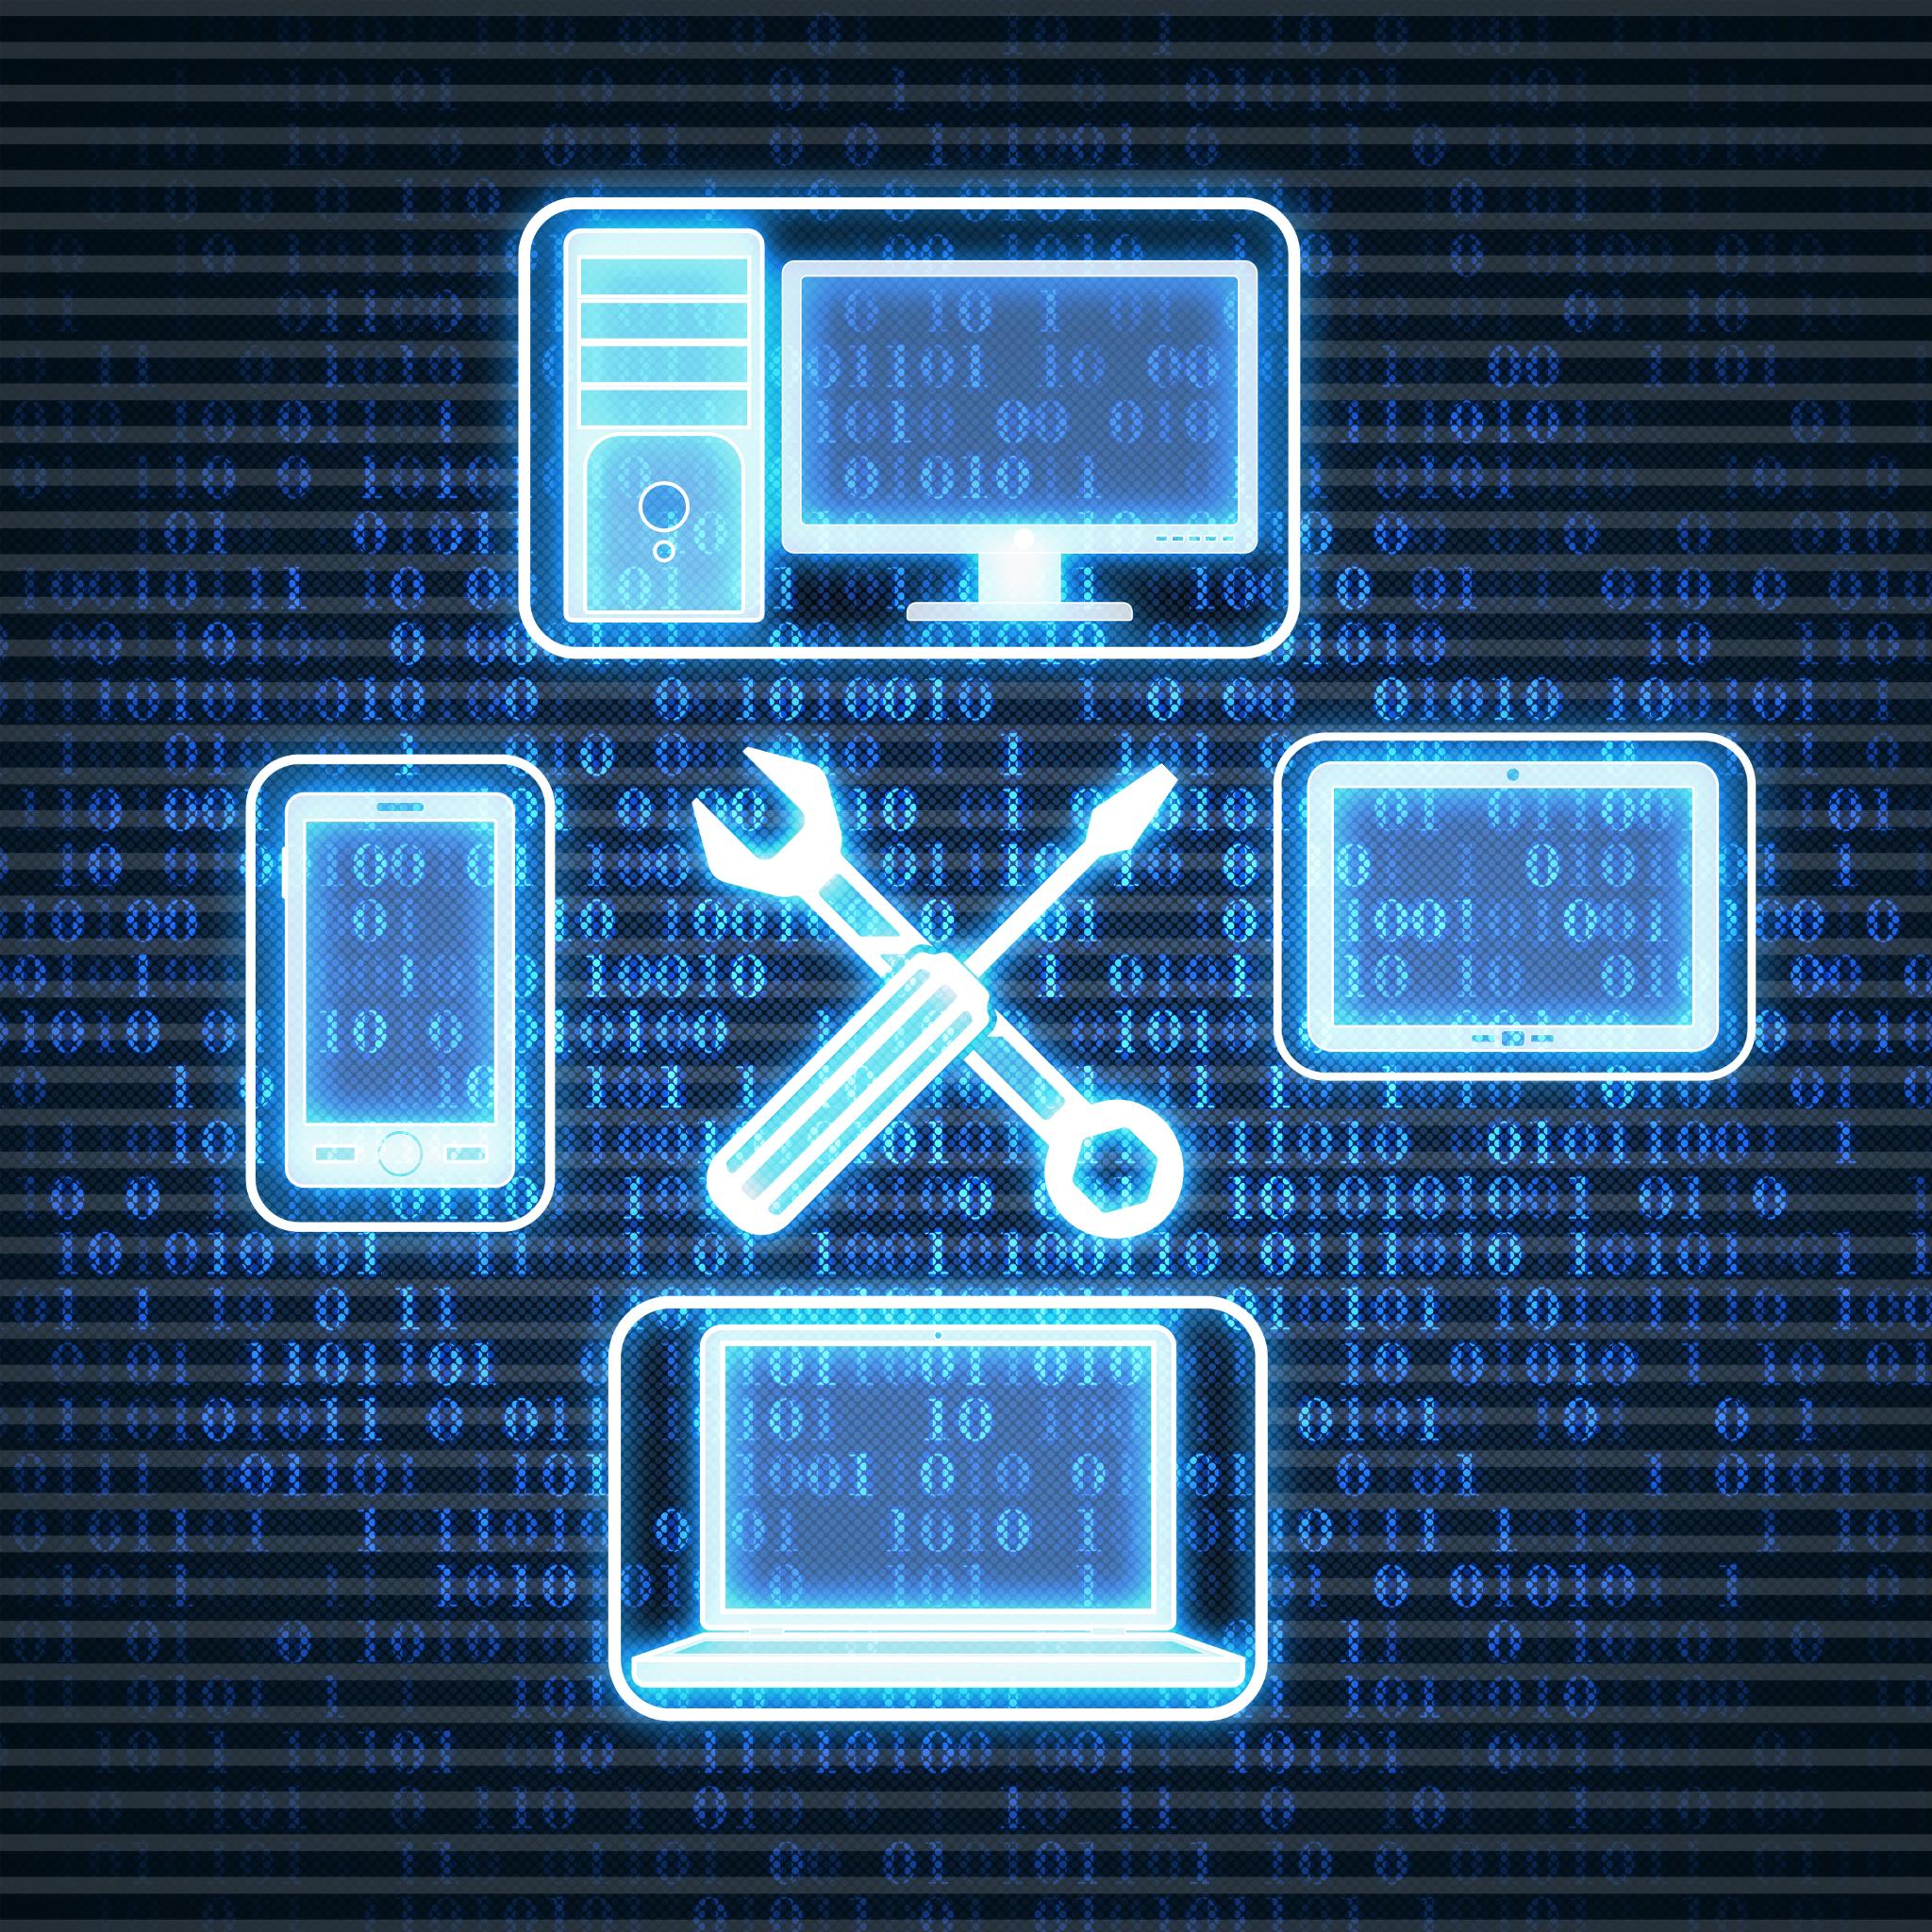
Testing Strategies and Debugging
Testing Strategies Overview
Testing verifies program functions and meets requirements through unit, integration, and system tests.
Debugging Process
Debugging complements testing by identifying and fixing code errors using tools like debuggers.
Benefits of Testing
Effective testing reduces production failures and improves user satisfaction with reliable software.
Notes:
Testing is a critical step in ensuring that a program functions as intended. It involves verifying that the program meets requirements and performs correctly under various conditions. Common testing strategies include unit testing, which checks individual components; integration testing, which ensures modules work together; and system testing, which validates the entire application. Debugging complements testing by identifying and fixing errors in the code. Tools like debuggers and automated testing frameworks streamline this process, allowing developers to trace issues efficiently. For example, in web applications, testing might involve validating form inputs, checking database interactions, and ensuring compatibility across browsers. Effective testing reduces the risk of failures in production and enhances user satisfaction. By incorporating systematic testing and debugging practices, developers deliver reliable, high-quality software that meets user expectations.

Slide 29
i. Phase 1 – Desk Checking
Desk checking is a manual method for code review or program verification in software development. This includes careful testing and analysis of code or algorithms by hand, without running the code on a computer. The purpose of desk checking is to identify errors, logic flaws, and potential problems in the code before it is actually executed.
This phase is similar to proofreading. It is sometimes avoided by the programmer who is looking for a short cut and is eager to run the program on the computer once it is written. However, with careful desk checking, you may discover possible errors and possibly save yourself time in the long run.
In desk checking, you simply sit down and mentally trace, or check the logic of the program to attempt to ensure that it is error free and workable.
Many organizations take this step a phase ahead with a walkthrough – a process in which a group of programmers review your program and offer suggestions in a collegial way.

Slide 30
ii. Phase 2 – Translating
Translating refers to the process of converting code written in one programming language into another language or form of programming. This is done by a translator.
A translator is a program that: checks the syntax of your program to make sure the programming language was used correctly, giving you all the syntax error messages, called diagnostics, and, then translates your program into a form the computer can understand.
A by-product of this process is that the translator can tell you if you have improperly used the programming language in some way. These types of errors are called syntax errors.
Programs are most commonly translated by a compiler. The translation involves your original program called a source module (source code), which is transformed by the compiler into an object module (object code, .obj).
There are also pre-written programs from a system library which may be added during the linking/loading of source code to object code. When this happens, it result will be the load module (executable code). The executable code can then be executed by the computer.

Slide 31
iii. Phase 3 – Debugging
Debugging is the process of identifying, analyzing, and correcting errors or defects (bugs) in a computer program. When developing software, it is common for problems to arise that prevent programs from working as expected. Debugging is a systematic approach to finding and fixing these problems, ensuring that the program works properly and produces the expected results.
The bugs (errors, mistakes) are logic errors, such as telling a computer to repeat an operation but not telling it how to stop repeating. Every data in a program must be tested.
Debugging requires patience, attention to detail, and a sensible approach to problem solving. This is an essential skill for programmers, as it helps ensure the reliability and functionality of the software. As programs become more complex, debugging can become more difficult, but with experience and effective use of debugging tools, developers can identify and fix problems quickly and effectively.
While debugging, there are three different types of errors that can be found which are:
Syntax Errors
Logic Errors
Run-time Errors

Slide 32
iii.1 Syntax Errors
Syntax errors are commonly misspelled programming language commands and grammatical problems with the way you used the programming language. These errors have to do with our use of the language.
In programming, we must obey the rules of the language or the program will not work.
Modern programming languages provide sophisticated syntax checkers, which even check the line of code you are writing as you write it, and if you make a syntax error, the development tool will warn you in some way. The warning may be that the code changes color to red, or a message may pop up on the screen.

Slide 33
iii.2 Logic Errors
Logic errors occur when your program is syntactically correct, but you told it to do something that is not what should really be done. This is caused by:
A failure to understand what the program should do or an incorrect algorithm. Logic error can be of many different form; one might be using the wrong operator in a calculation such as multiplying two numbers when you meant to divide one by the other – this type of error is hard to find as the code will usually execute without complain, but the output data will be incorrect.
Putting statements in the wrong order.
Leaving out some essential steps in algorithms.
Changing the wrong data in a database file.
Imagine the banking program which, each time you withdraw some money from your account, the money is added back to the balance. So instead of subtracting, the money withdrawn is added onto your balance. (In your dream only, of course!)

Slide 34
iii.3 Runtime Errors
Runtime errors occurs in a computer program during execution when a certain condition or situation occurs that the program was not designed or prepared to handle. . Unlike syntax errors that are detected by the compiler, runtime errors occur during program execution and can cause unexpected behavior or errors.
Runtime errors might be as simple as:
Opening a file which no longer exist.
Attempting to work with a software object using wrong name or path.
Performing a calculation which results in a very large number and then trying to assign it to a variable which is too small to hold it.
Expecting to receive data of a specific type but receiving data of a type which does not match.

Slide 35
Good programmers will try to avoid this runtime error using a range of strategies including:
Careful desk checking.
Peer review of the code by someone who didn't write it.
Writing code which anticipates errors like those above and deal with them when they do occur.
Compilers and interpreters locate your program’s errors when you try to compile or run it. Your computer will tell you where the errors are.

Slide 36
2.2.5: Step 5 – Documenting the Program
Documenting is an ongoing, necessary process. It is a written detailed description of the programming cycle and specific facts about the program.
Typical program documentation materials include; the origin and nature of the program, a brief narrative description of the program, logic tools such as flowcharts and pseudo code, data recorded descriptions, program listings, and testing results.
Comments in a program are also considered an essential part of documentation. Many programmers document as they code. In a broader sense, program documentation can be part of the documentation for an entire system.
Wise programmers continue to document the program throughout its design, development and testing. This is because document is needed to supplement human memory and to help organize program planning.
In addition, document is critical to communicate with others who have an interest in the program, especially other programmers who may be part of a programming team.
Moreover, since turnover is high in the industry, written documentation is needed so that those who come after you can make any necessary modifications in the program or track down any errors that you missed.

Slide 37
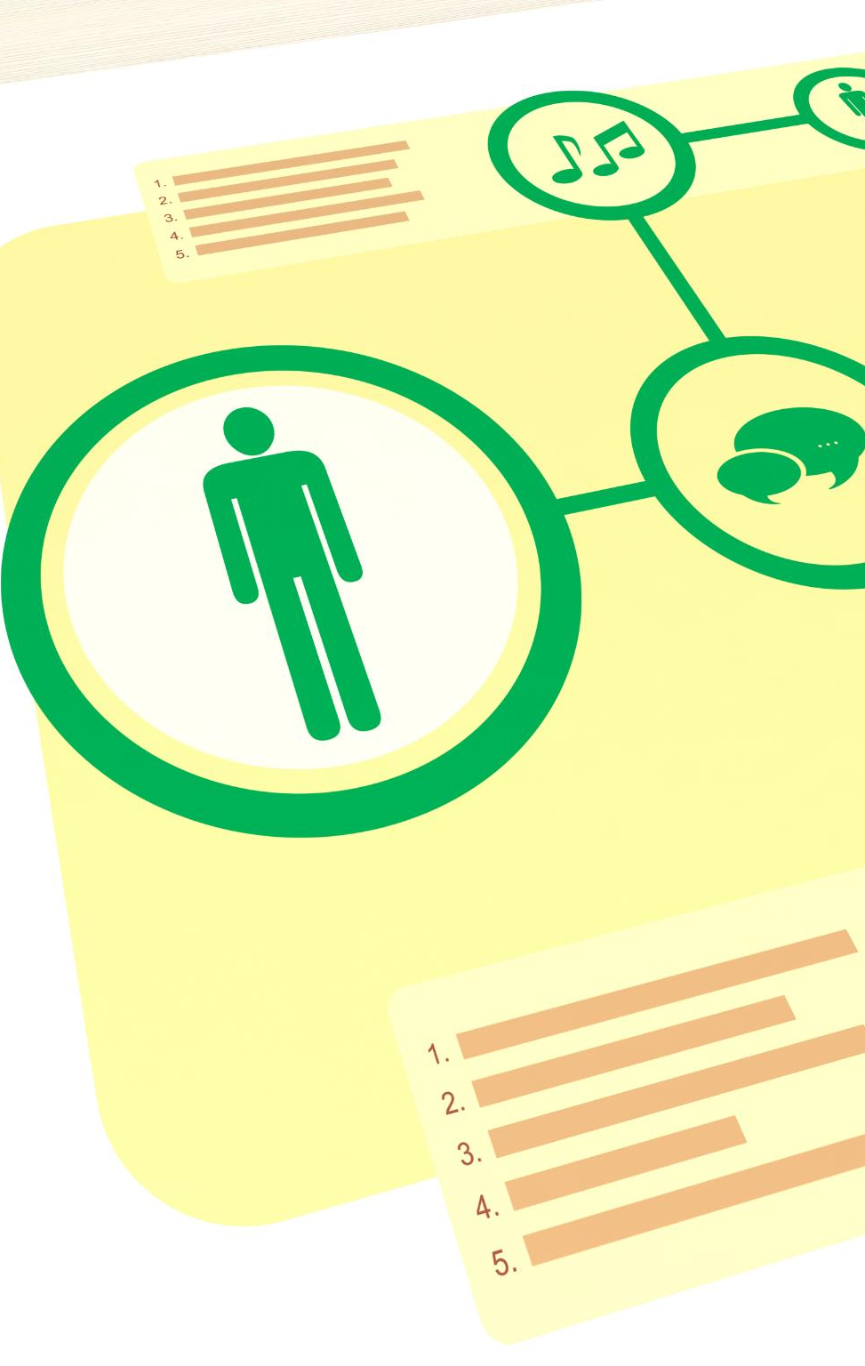
Importance of Documentation
Role of Internal Documentation
Internal documentation includes code comments that clarify logic for future developers and ease program maintenance.
Purpose of External Documentation
External documentation like user manuals and guides helps end-users and support teams use software effectively.
Ensuring Project Continuity
Good documentation supports continuity in large projects, facilitating upgrades, troubleshooting, and team transitions.
Benefits of Prioritizing Documentation
Prioritizing documentation alongside coding creates sustainable, user-friendly, and maintainable software.
Notes:
Documentation is an often-overlooked aspect of software development, yet it plays a vital role in program usability and maintenance. Internal documentation includes comments within the code that explain logic and functionality, aiding future developers in understanding the program. External documentation encompasses user manuals, installation guides, and technical specifications, which help end-users and support teams operate the software effectively. Good documentation ensures continuity, especially in large projects where team members may change over time. For instance, enterprise systems rely heavily on detailed documentation to facilitate upgrades and troubleshooting. Without proper documentation, even well-written code can become difficult to maintain, leading to increased costs and delays. By prioritizing documentation alongside coding and testing, developers create software that is not only functional but also sustainable and user-friendly.

Slide 38
Types of Documentation
1. User Documentation
In programming, user documentation refers to the written documents, tutorials, and resources provided to users of a software system or application. It provides instructions, explanations, and information that help users understand, use, and interact effectively with the software. User documentation plays an important role in ensuring that users can get the most out of the software's features and functions without confusion or frustration.
The purpose of this documentation is to explain the features of the software and describe how to use them. It is intended to be used by the user of the software and is therefore expressed in the terminology of application.
Today, user documentation is recognized as an important marking tool. Good user documentation combined with well-designed user interface makes a software package accessible and thus increase its sales.
Recognizing this, many software developers hire technical writers to produce this part of their product.

Slide 39
2. System Documentation
System documentation in programming refers to a collection of documents and resources that provide detailed information about the design, architecture, implementation, and operation of a software system. It aims to provide a comprehensive understanding of how a software system works, how its components interact, and how it can be maintained, operated, and changed over time.
System documentation is important for developers, administrators, and other stakeholders who need to work with or manage software systems.
The purpose of this documentation is to describe the software’s internal composition so that the software can be maintained later in its life cycle.
A major component of the system documentation is the source version of the entire program in the system. It is important that this program be presented in a readable format, which is why software engineers support the use of well-designed high level-programming languages.

Slide 40
3. Technical Documentation
Technical programming documentation refers to a collection of documents and resources that provide detailed and comprehensive information about the technical aspects of a software application, system, library, or component. It is aimed at developers, programmers, system administrators, and other technical actors who need to understand the inner workings of software and its technical implementation.
The purpose of this documentation is to describe how a software system should be installed and serviced, such as installing updates and reporting problems back to the software developer.
The distinction between technical and user documentation is blurred in the PC arena because the user is a person who also install and services the software.
However, in multi-environment, the distinction is sharper. Therefore, technical documentation is intended for a system administrator who is responsible for servicing all the software under his/her jurisdiction, allowing the users to access the software, packages and tools.

Slide 41
2.3 Structured Programming
Structured programming is a philosophy stating that programs should be written in an orderly fashion without a lot of jumping to and fro. It is a programming paradigm that emphasizes the use of structured control flow structures to write clean, organized, and maintainable code.
You have understood flow charts and pseudo code, so you can see what structured programming is all about with those tools.
The structured programming is a specific approach to programming that generally produces well-written and easily read programs.
The structured programming include three constructs. A construct is a building block of a language and one of the languages fundamental operations. They ensure that a program doesn't branch all over the place and that any execution is controlled and easily followed.

Slide 42
Constructs of Structured Programming
1. Sequence
Sequence is nothing more than two or more instructions one after another.
(Refer to Book 1, page 43 - 44)
2. Decision
Decision is a break from the sequential program, but it is a controlled break.
The decision symbol in a flowchart is a point at which a decision is made. Anytime a program makes a decision, it must take off in one of the two directions.
(Refer to Book 1, page 44 - 45)
3. Looping
Looping is the repetition(iteration) of a program. A computer can repeat sections of a program millions of times and never become bored.
Programs are more powerful when they can repeat a series of sequential statements or decisions.
Loops only temporarily break the rule that says flowcharts always flow down and to the right.
(Refer to Book 1, page 46)

Slide 43
2.4 Data Types
A data type is a classification that defines the type of value a variable can contain. They define the format of data that can be stored in a variable, how the data is represented in memory, and the operations that can be performed on the data.
A program should hold data that they work with within memory location called variable. The amount of memory used for a variable depend on how much it has to hold, and that, in turn depends on what the data consist of.
They are many different types of data that a program needs to work with and each programming language support a range of data types, and has rules about what we can do about each data types.
Most data that a program works with could be classified into the following types:
1. Character Data 4. Real Numbers
2. String Data 5. Boolean
3. Integers 6. Date and Time

Slide 44
1. Character Data (char)
Character data, which is referred to as "char" data, is a data type used in programming to represent individual characters, such as letters, numbers, symbols, and spaces.
Characters are the building blocks of text and strings in programming languages.
2. String Data (string)
String data, which is referred to as "string", is a data type used in programming to represent string literals. They are used to store textual data, such as words, sentences, and paragraphs.
Therefore, strings can also be referred to as sequence of characters.
Computer programs frequently deals with character string to hold data such as names, address, or telephone numbers.

Slide 45
3. Integer (int)
Integer which is referred to as ‘int’ is a data type used in programming to represent whole numbers, positive and negative, with no decimals or fractional parts.
4. Real Numbers (float)
Real numbers (floating-point) are numbers that may have a remainder and may exist as positive or negative numbers. They are used to represent real quantities using decimal points and fractions
Floating point numbers include both rational numbers (numbers that can be represented as fractions) and irrational numbers (numbers that cannot be represented as fractions).

Slide 46
5. Boolean (bool)
Boolean, which is referred to as "bool", represents data which can be expressed as true or false.
Booleans are essential for making decisions about code and controlling the flow of program execution based on certain conditions.
5. Date and Time
The date and time data type allows you to store and manipulate information about dates, times, and timestamps (specific time).
This data type is specially designed to handle different aspects of date and time, including year, month, day, hour, minute, second, etc.

Slide 47
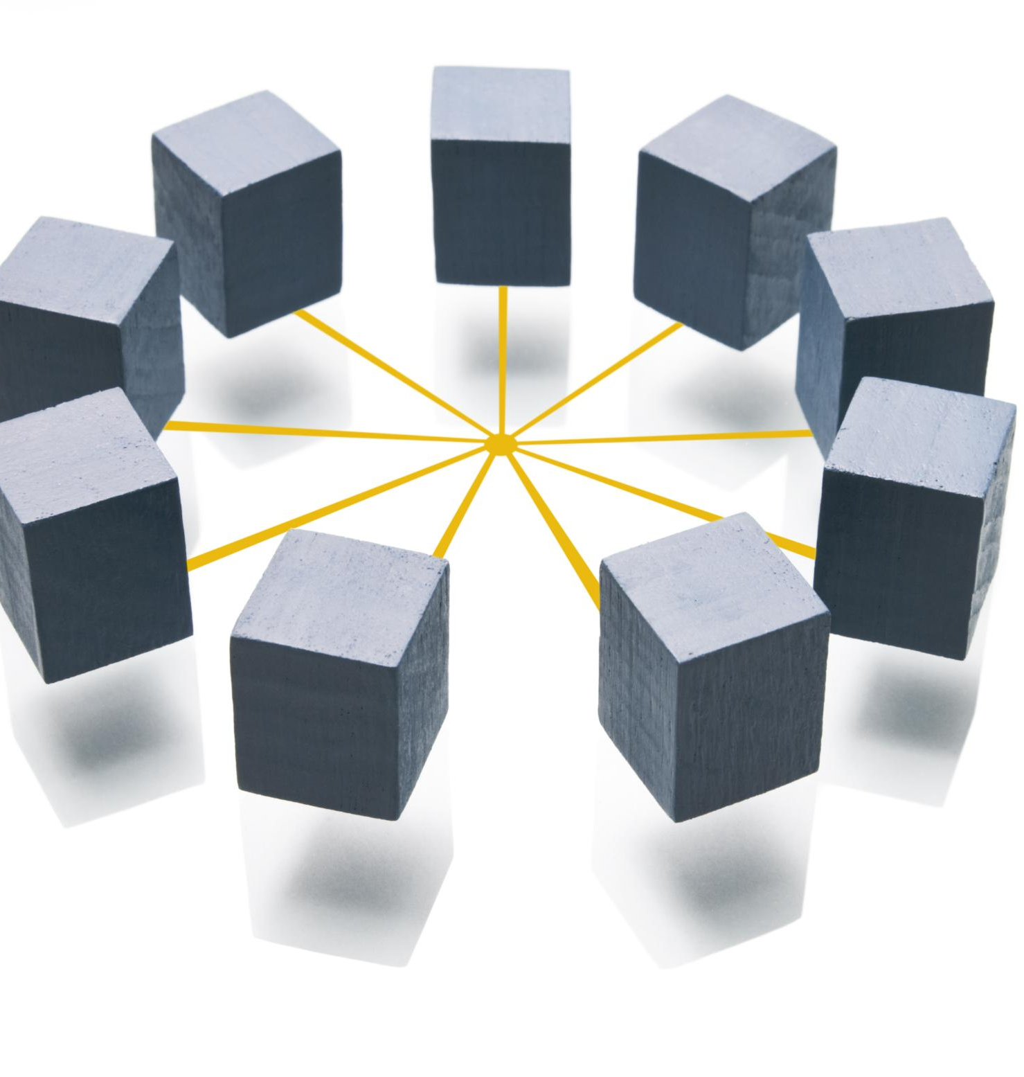
Principles of Structured Programming
Core Control Structures
Structured programming relies on sequence, selection, and iteration to ensure logical program flow.
Modularity Benefits
Dividing programs into reusable modules improves debugging, testing, and maintainability.
Language Support Examples
Languages like C and Python implement structured programming with functions and control statements.
Notes:
Structured programming is a programming paradigm that emphasizes clarity, simplicity, and logical flow. It is based on three primary control structures: sequence, selection, and iteration. Sequence refers to executing instructions in a specific order, selection involves decision-making using constructs like if-else statements, and iteration handles repetitive tasks through loops. These principles reduce complexity and make programs easier to understand and maintain. Structured programming also promotes modularity, where programs are divided into smaller, reusable components. This approach enhances debugging and testing, as individual modules can be verified independently. For example, languages like C and Python support structured programming through functions and control statements. By adhering to structured programming principles, developers create reliable, efficient, and scalable software solutions that align with industry best practices.

Slide 48
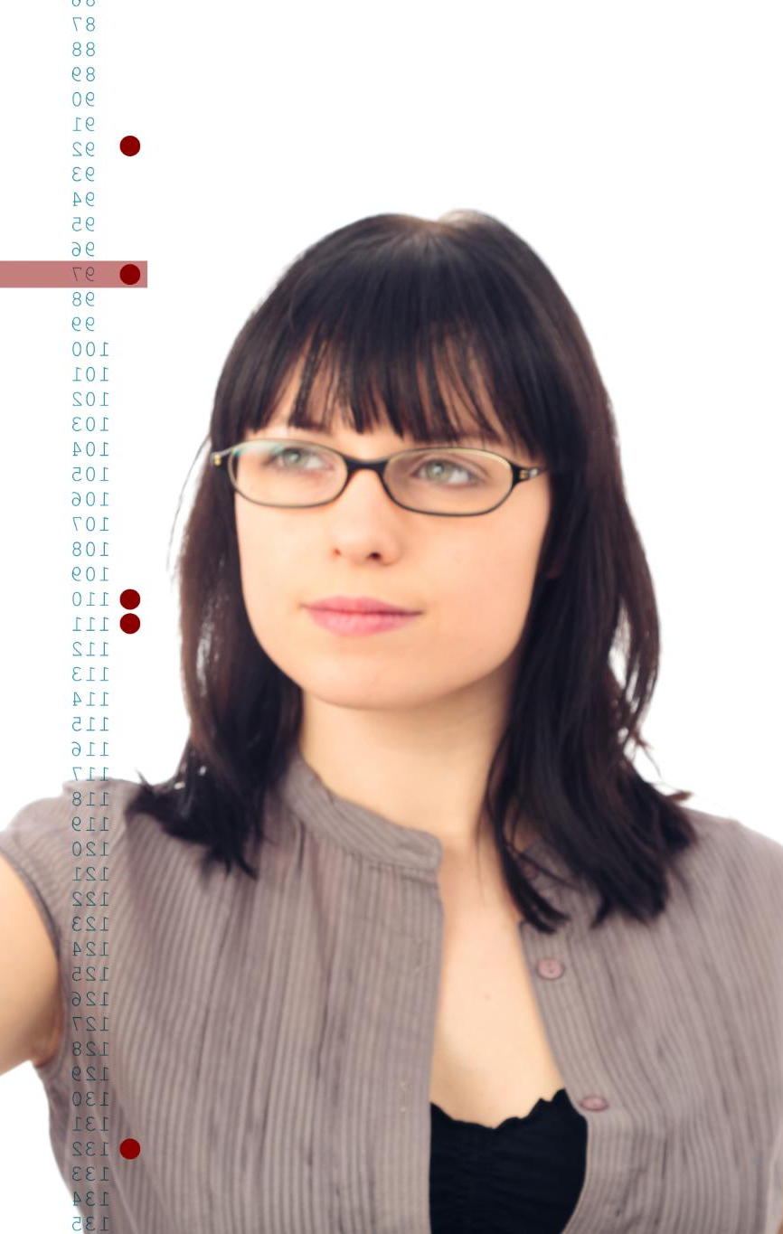
Understanding Data Types
Basic Data Types
Numeric, string, and Boolean types represent fundamental data forms used in most programming tasks.
Composite Data Types
Arrays and structures group related data elements, enabling organized data management.
Choosing Correct Types
Selecting the right data type ensures accuracy and efficiency, avoiding errors like rounding in currency calculations.
Type Safety in Programming
Modern languages enforce type rules to prevent invalid operations, enhancing code reliability.
Notes:
Data types define the kind of data a program can process and how it is stored in memory. Common data types include numeric types (integers and floating-point numbers), which handle mathematical operations; string types, used for text manipulation; and Boolean values, which represent true or false conditions. Composite types, such as arrays and structures, allow grouping of related data elements. Choosing the correct data type is crucial for program efficiency and accuracy. For instance, using an integer instead of a floating-point type for currency calculations can lead to rounding errors. Modern programming languages enforce data type rules to prevent invalid operations, such as adding a number to a string. Understanding data types enables developers to write robust code that performs reliably across different scenarios. This knowledge is fundamental for building programs that handle data effectively and avoid common pitfalls.

Slide 49
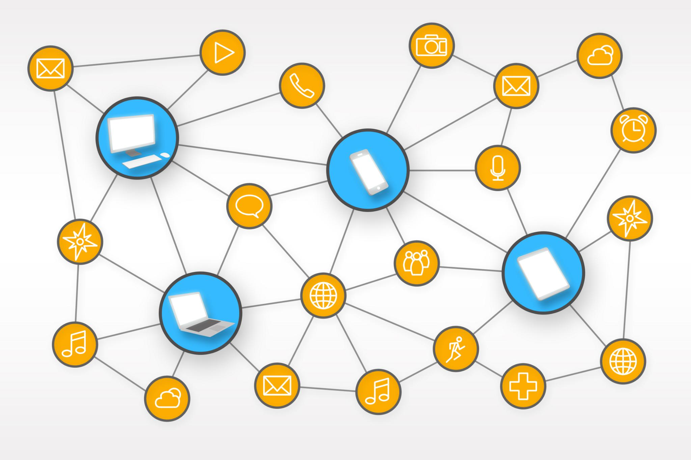
Summary of Program Design and Structured Techniques
Importance of Program Design
Investing time in program design creates clear, logical plans that reduce errors and improve development efficiency.
Structured Programming Principles
Sequence, selection, and iteration ensure programs are organized, maintainable, and easy to understand.
Role of Data Types
Understanding data types influences how data is processed and stored in software applications.
Testing and Documentation
Testing validates functionality while documentation supports long-term maintenance and user understanding.
Notes:
Program design and structured techniques form the backbone of effective software development. By investing time in design, developers create clear, logical plans that reduce errors and improve efficiency. Structured programming principles, including sequence, selection, and iteration, ensure that programs are organized and maintainable. Understanding data types is equally important, as it influences how data is processed and stored. Testing and documentation complement these practices by validating functionality and supporting long-term maintenance. Together, these elements enable developers to build reliable, scalable, and user-friendly software solutions. For students pursuing a Certificate in Computing, mastering these concepts is essential for success in programming and related fields. By applying these principles consistently, learners can tackle complex problems with confidence and deliver high-quality software that meets user needs.

Slide 50
Summary and Review Exercises
Read Chapter Summary Notes on Page 49 of Introduction to Programming Book 1.
Complete all 8 review questions on Page 50 - 51 of Introduction to Programming Book 1.

